Slide 1
Neural Network

Slide 2
Neural networks are examples of
Non-Linear hypothesis,
where the model can learn to classify much more complex relations.
Also it scale better than Logistic Regression for large number of features.

Slide 3
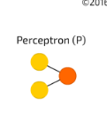

Slide 4
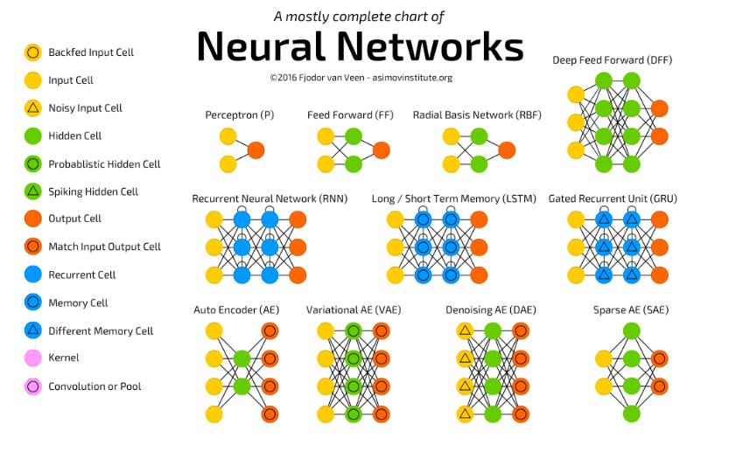

Slide 5
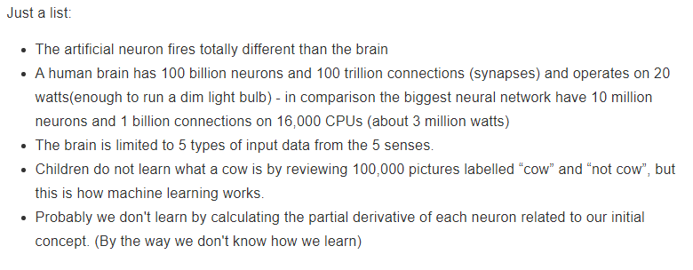
Differences

Slide 6
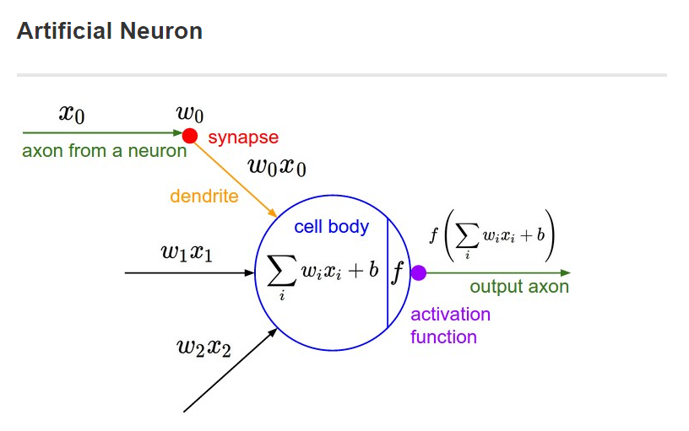

Slide 7
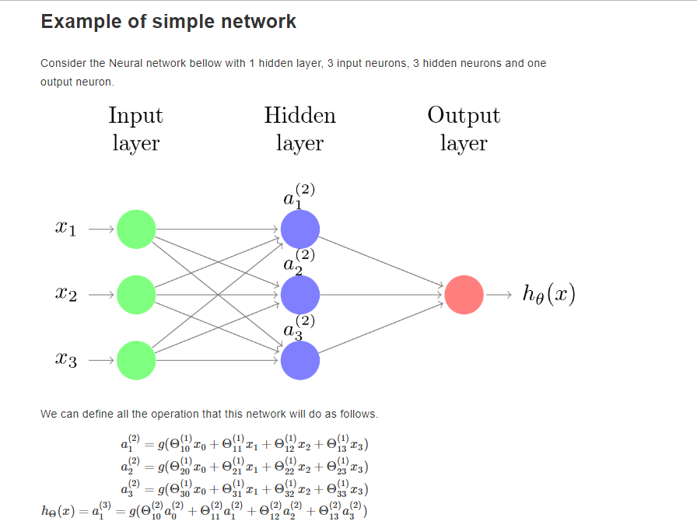

Slide 8
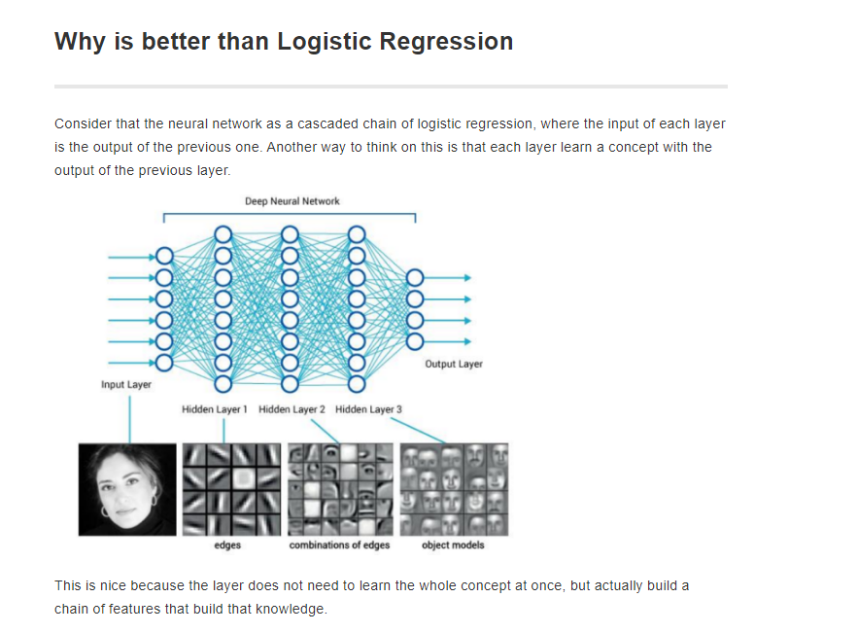

Slide 9
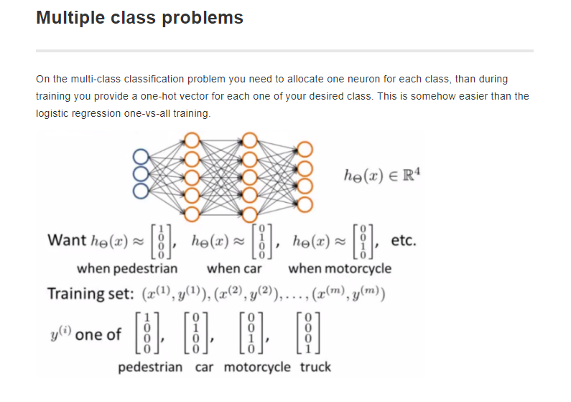

Slide 10
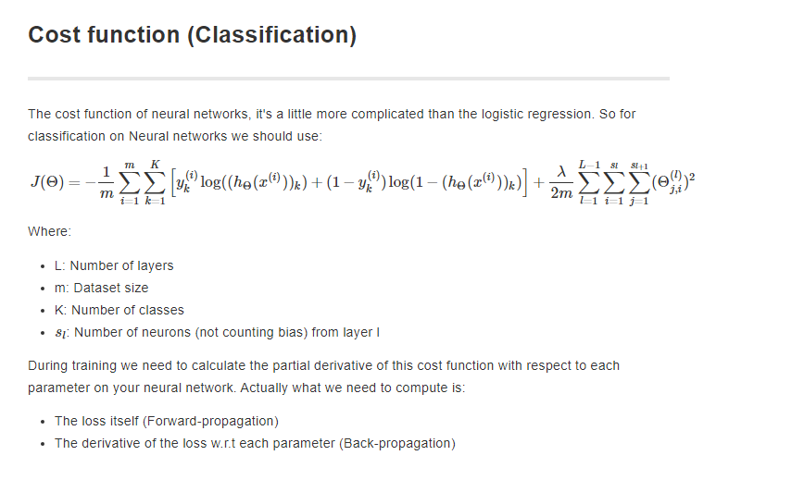

Slide 11
